Slide 1
Reward Based Waste Management System
Application Engineering Design - Final Project
Sethu Surya Teja Pagolu (002122149)
Varun Vuppala (002193132)
Saketh Ram Gangam (002199297)

Slide 2


Problem Statement
Despite many efforts from communities and governments around the world, Waste Management is still an immense challenge today. The crux of the problems in handling waste is waste sorting. To enable individuals and organizations responsibly dispose waste, there are only few rewarding options if not none.

Slide 3

Proposed Solution
Reward Based Waste Management System is a network of competing entities which provides organizations that engages in waste sorting, more reasons to continue working for the social cause by gifting them with rewards for doing so.
Sort & Report Waste Organizations or entities sort the waste they accumulate and send a report
Auction and delivery of Sorted Waste Reported waste is sent for auction and is open to accepts bids Once the bid is accepted, logistics and payments are dealt with
Complete Orders and Earn Rewards More waste is sorted and sent to recycling, more rewards can be redeemed

Slide 4

Working & Key Roles
Waste Segregation Unit (WSU)
An organization in WSU is responsible for sorting the waste according to the waste types and reporting them to the system. Below are the key roles of a WSU.
WSU Admin
Manage Waste Reporting Employees
Conduct auction to sell Waste & accept bids
Manage Earnings and Redeem as Vouchers/cash
Waste Reporting Manager
Report Waste Sorted to WSU Admin
Manage Sorted Waste

Slide 5

Working & Key Roles
Logistics Unit (LU)
A Logistics organization is responsible for pickup and delivery of the segregated waste
LU Admin
Manages Pick-up orders
Assigns Drivers
Calculates Delivery fees
Driver
Delivers the shipment at the Waste Recycling Organization
Updates the status of the delivery

Slide 6

Working & Key Roles
Waste Recycling Unit (WRU)
Waste recycling unit is responsible for recycling or reusing of segregated waste.
WRU Admin
Manages Waste Recycling Unit Employees
Manages bids to buy segregated waste
Manages Expenditure on Bids & Logistics
WRU Employee
Places bids to buy segregated waste

Slide 7

Working & Key Roles
Volunteer Unit (VU)
An organization in VU is responsible for segregation and reporting waste.
VU Admin
Manages Volunteers that are part of the VU
Reports the waste segregated for a WRU to pick up
Volunteer
Segregates the waste and reports it to the VU

Slide 8

Working & Key Roles
Rewards Unit (RU)
An RU organization is responsible for sponsoring and providing rewards in the form of vouchers or cash.
RU Admin
Manages rewards from various participating companies

Slide 9
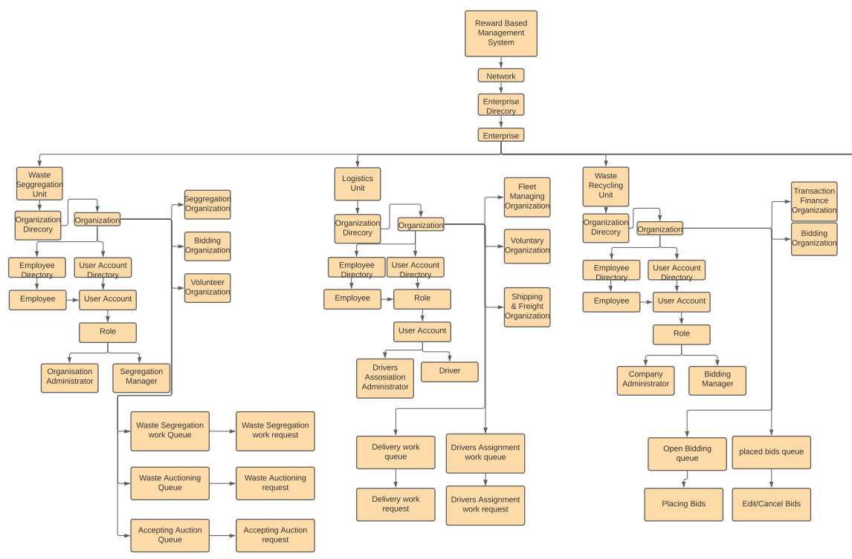
Object Model

Slide 10
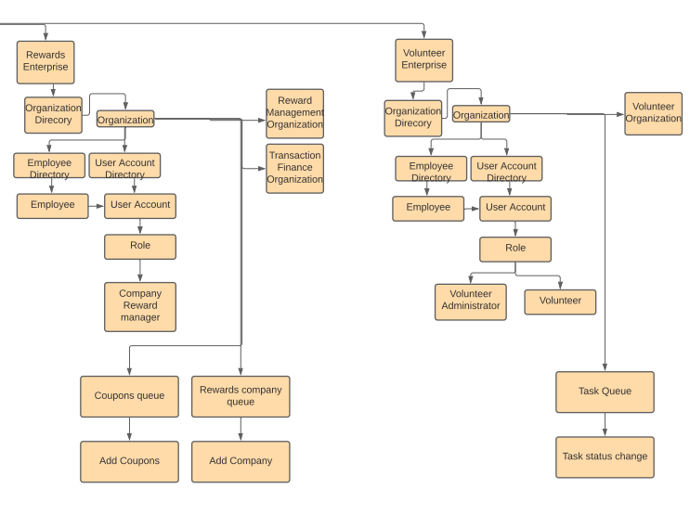
Object Model (Cont.)

Slide 11
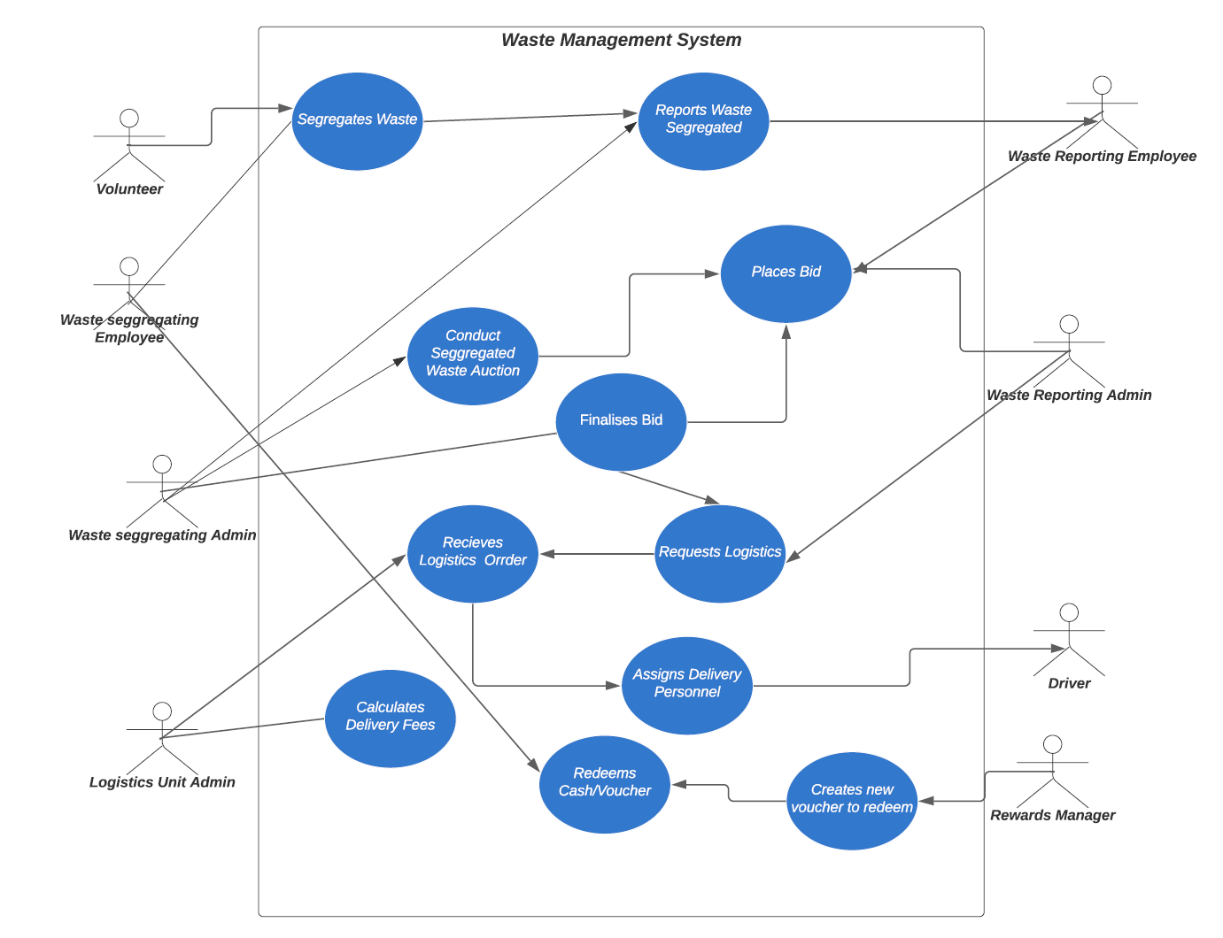
Use Case Diagram

Slide 12
Thank You!

